Slide 1
Managing the Supply Chain Mr. Dan Christenson 748 SCMG/EN E-mail: dan.christenson@us.af.mil
6 August 2019

Slide 2
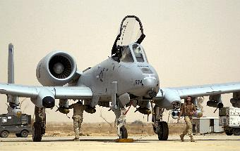
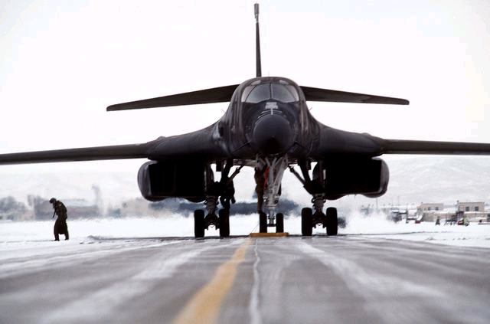
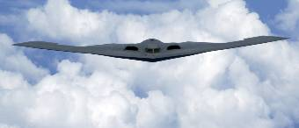
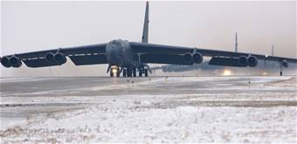
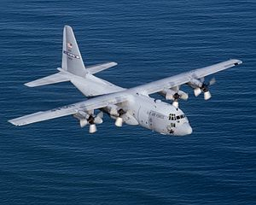
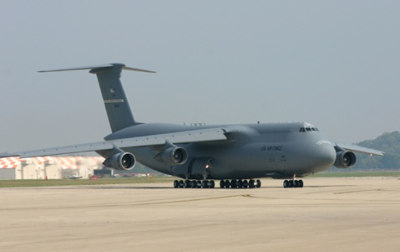
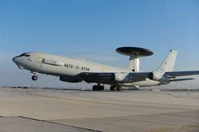
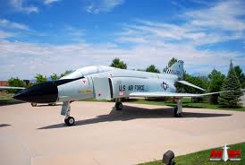
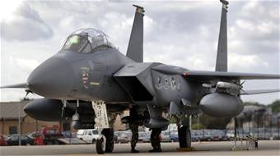
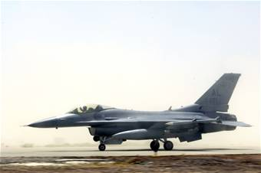
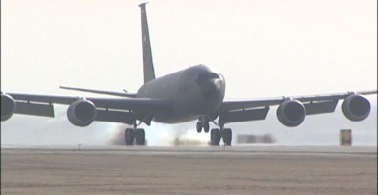
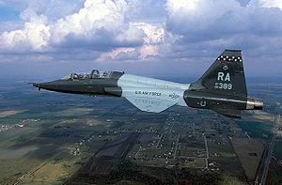
Supply Chain Challenge Aging Fleets
A-10 – 47 yrs (1972)
B-1B – 45 yrs (1974)
B-2 – 28 yrs (1989)
B-52 – 67 yrs (1952)
C-130 – 65 yrs (1954)
C-5 – 51 yrs (1968)
E-3A – 47 yrs (1972)
F-4 – 61 yrs (1958)
F-15 – 47 yrs (1972)
F-16 – 45 yrs (1974)
KC-135 – 63 yrs (1956)
F-5/T-38 – 60 yrs (1959)
As of Aug 2019
2

Slide 3
Engineering Activities
DMSMS (Obsolete/Unprocurable Parts)
Develop new sources
Re-Engineering
Counterfeit Parts

Slide 4
Questions?

